Slide 1
Provider Management: Admin User Training
Presented By:
Lucía Lapaz, Brittany Ersery & Jim Holsinger
Envision Technology Partners, Inc.
September 2019

Slide 2
Agenda
Overview
Notifications
Change Requests
Notes
Case Management
Fraud & Abuse Complaint
Tools Settings
Enrollment Templates
Enrollment Review
User Registration
Reports

Slide 3
Overview
Provider Management (PM) modules:
Clinic Tools
Program Tools
Ability to manage refrigerator, freezer, and temperature monitoring assets per clinic
Eases the burden of data entry off the Program by enabling Clinics to request changes
Provides case management feature to document and investigate a Clinic, including fraud and abuse investigation
Automates VFC and 317 enrollment

Slide 4
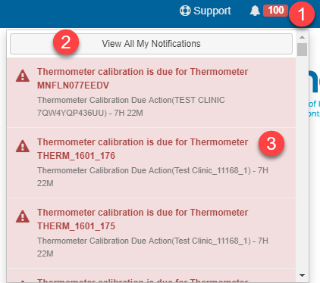
Notifications
Users with Program Tools module permissions and the PM-Change Request Action Group security functions will receive notifications when change requests are submitted for approval.
Click bell icon to view notifications.
Click View All My Notifications to navigate to main page.
Click a specific notification to navigate to the corresponding page for the selected Clinic.

Slide 5
Notifications (cont.)
Select desired Filter Options.
Click Filter to apply selected filter options and view filtered results.
Click VIEW to navigate to the screen corresponding to the notification.

Slide 6
Change Requests
Certain change requests submitted by clinics require approval from the Program. The following generate Action (red) notifications:
Clinic Name and/or Address changes
Staff changes
New Storage Unit
Complaint published for approval
Other change requests do not require approval, but the Program is still notified of the changes. The following generate Alert (yellow) notifications:
Contact Information (Phone, Fax) changes
Delivery Hours changes

Slide 7
Name/Address Change Request
Fields changed by the clinic are highlighted in red.

Slide 8
Name/Address CR (cont.)
Click View Current Info to switch to the clinic’s current name and address (with ability to toggle between current and requested values).
Click Add to add any notes regarding this clinic’s change request.
Click Approve to approve the changes, or click the arrow to Reject the changes.

Slide 9
Staff Change Request
Click VIEW to open a pending staff change request.
Then, approve or reject the staff change request.

Slide 10
Storage Unit Change Request
Change Status from Pending Approval to Active.
Then, click Update to save the Status change.

Slide 11
Notes
Navigate to Program Tools > Notes.
Click Add Note to create a new note.
Select desired filter options and click Filter to view results.
Notes:
The notes view is for Program/Jurisdictional users only and aggregates notes from all Clinics into one area. The view allows a user to gather actionable data using a variety of filters including date range, Provider, Clinic, category, and Cases. After filtering the data the user can export a pdf or csv document for reporting purposes.

Slide 12
Case Management
Cases are created from Notes
Cases can also be created from the View Cases list
Notes:
Cases give Program/Jurisdictional users a way to manage Clinic investigations collaboratively. Cases are created from Notes or from the View Cases list.
If a Case has been created from a Note the contents of the Note are automatically entered into the Case description text area input and the originating note relationship changes to be associated to the case.
The category of the Case is defaulted to the same as the Note, but can be changed here in the Case if necessary.

Slide 13
Add Case

Slide 14
Fraud & Abuse Complaint
A Case with a category of “Fraud & Abuse” can be escalated to a Fraud & Abuse Complaint

Slide 15
Fraud & Abuse Complaint (cont.)
Once a Case has been escalated to a Complaint, additional fields become required
Once the Complaint has been saved, it can be exported to PDF for reviewers to sign

Slide 16
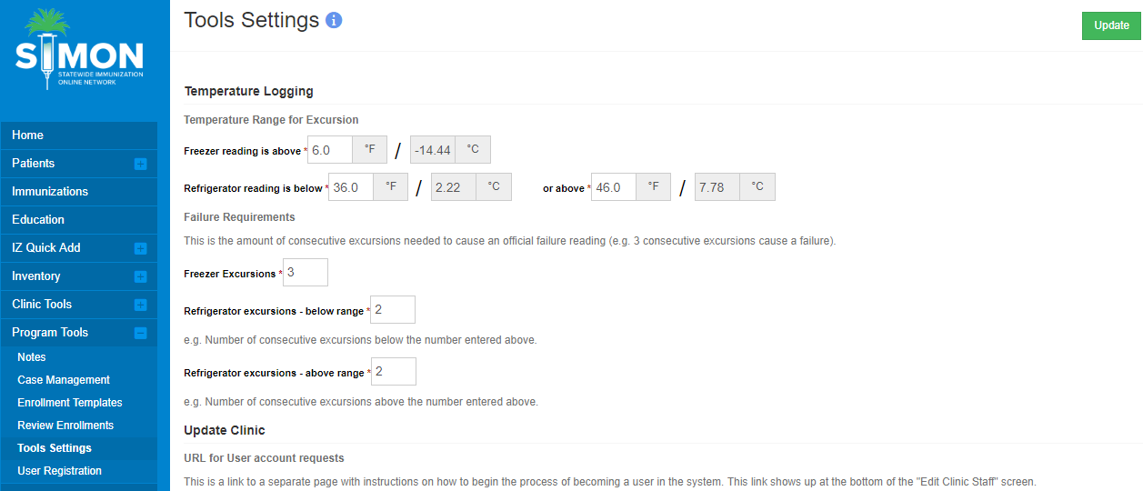
Tools Settings
Set temperature range for excursion
Set failure requirements
Notes:
This functionality allows Program users to put in settings that are used in various other parts of the application. These settings are used for every Clinic the Program manages.
The Settings are comprised of temperature reading settings mostly, with a section for a user account instruction URL also. Note that for temperature reading settings, there will be a system-wide default used if these Settings are not set for the Program.

Slide 17
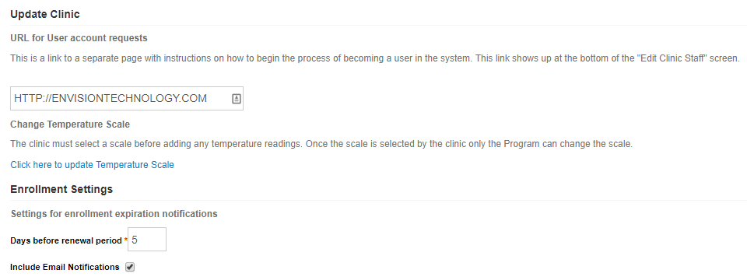
Tools Settings (cont.)
Enter URL for user account requests
Update Temperature Scale (F°/C°)
Define Enrollment Settings

Slide 18
Enrollment Templates

Slide 19
Enrollment Templates
Users with the following access can create enrollment templates:
Program Tools module access
PM – Manage Enrollments user security function
Each template contains accordions for the following sections:
Options
Assets
Required Staff and Training
Required Forms
Additional Requirements
Once all sections are complete, a template can be made Active, which allows clinics to submit enrollments

Slide 20
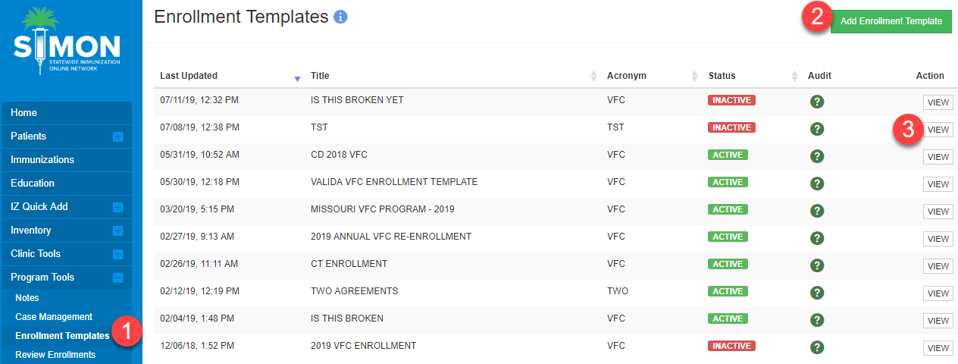
Enrollment Templates: View/Add
Navigate to Program Tools > Enrollment Templates.
Click Add Enrollment Template to create a new template.
Click View to modify an existing template.

Slide 21
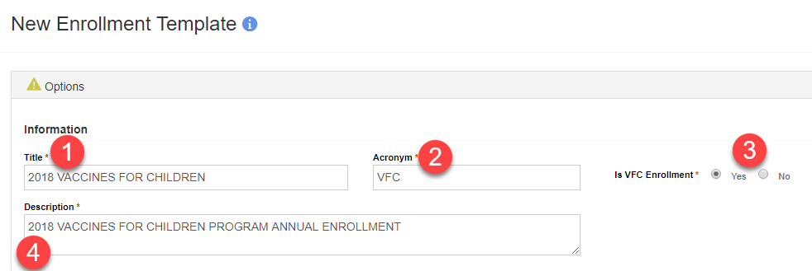
Options
Enter a Title for the template.
Enter an Acronym for the template. (5 character max.)
Indicate if the template is for VFC Enrollment.
Enter a brief Description of the template.

Slide 22
Options (cont.)
Select if Renewal Period will be Annual Enrollment (i.e., every year during a specific date range).
Select if Renewal Period will be One year from time of enrollment (i.e., annually).
Click Choose File to upload a Checklist for clinics to complete before the enrollment is submitted.

Slide 23
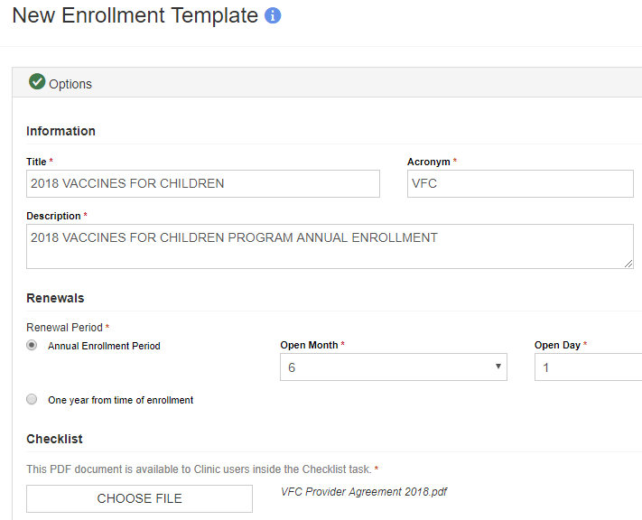
Options (cont.)
When a section is complete, the icon in the accordion header changes from to .

Slide 24
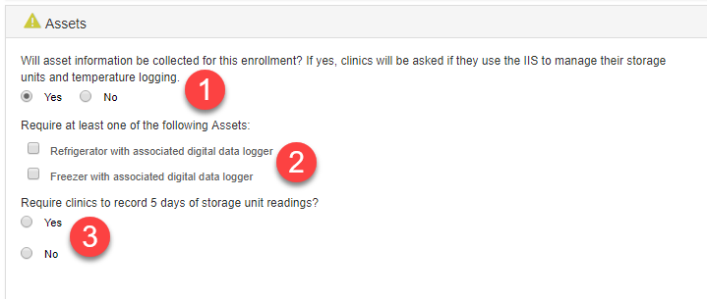
Assets
Indicate if asset information will be collected for this enrollment.
If asset information will be collected, select to require refrigerator and/or freezer.
Indicate if clinics are required to record 5 days of temperature readings.

Slide 25
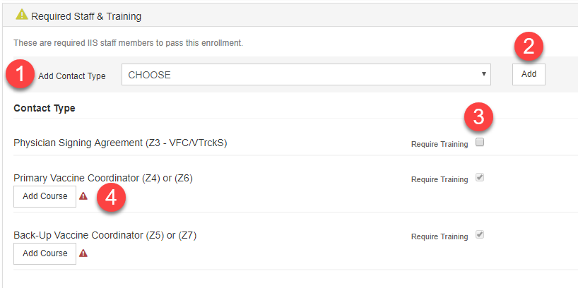
Required Staff & Training
Select from Add Contact Type to require additional staff.
Click Add to require staff/contact type selected in step 1.
Select to Require Training for Physician Signing Agreement (Z3).
Click Add Course to specify course(s) required for each contact.

Slide 26
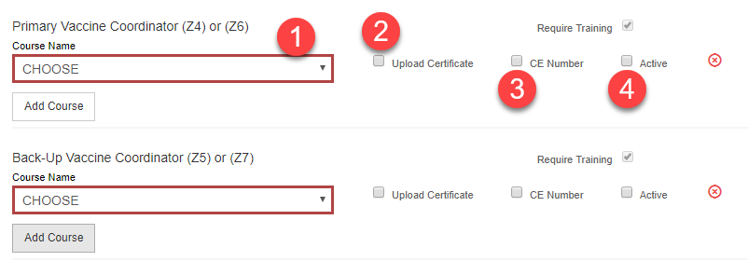
Required Staff & Training (cont.)
Select Course Name from list (populated in code tables).
Optional: Require clinic to Upload Certificate for staff member and course.
Optional: Require clinic to enter CE Number for staff member and course.
Select Active to make the training requirement active for the contact.

Slide 27
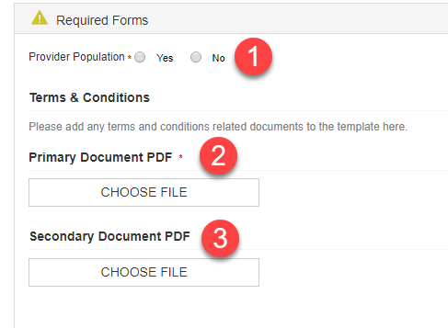
Required Forms
Indicate whether Provider Population is required.
Upload the Primary Document PDF, which clinics must electronically sign.
Optional: Upload a Secondary Document PDF for clinics to electronically sign.

Slide 28
Provider Population
If Provider Population = Yes, define patient age ranges and eligibility/non-eligibility categories to create a grid for clinics to complete at enrollment.
Notes:
If Provider Population = Yes, define patient age ranges and eligibility/non-eligibility categories to create a grid for clinics to complete at enrollment.

Slide 29
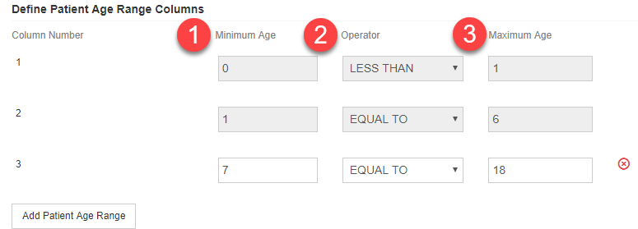
Define Patient Age Range Columns
For each Patient Age Range Column, the following are required:
Minimum Age
Operator
Maximum Age

Slide 30
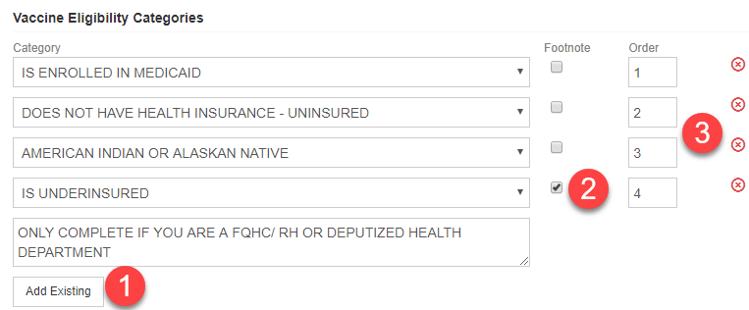
Vaccine Eligibility Categories
Click Add Existing to add a vaccine eligibility category row.
Select to add a Footnote to a vaccine eligibility category row.
Specify the Order in which the category rows should display.
Notes:
Category = defined in VFC Codes table in Administration module.

Slide 31
Non-Eligibility Categories
Click Add Existing to add a non-eligibility category row.
Select to add a Footnote to a non-eligibility category row.
Specify the Order in which the category rows should display.
Notes:
Category = defined in VFC Codes table in Administration module.

Slide 32
Additional Requirements
Identify additional requirements displayed to the Program when reviewing the enrollment
Options are managed via the code tables

Slide 33
Save Enrollment Template
Click Save Progress to save all changes.
Click slider to change template from Inactive to Active, making it available to Clinics.
Once used by a Clinic, the template cannot be edited.

Slide 34
Review Enrollments

Slide 35
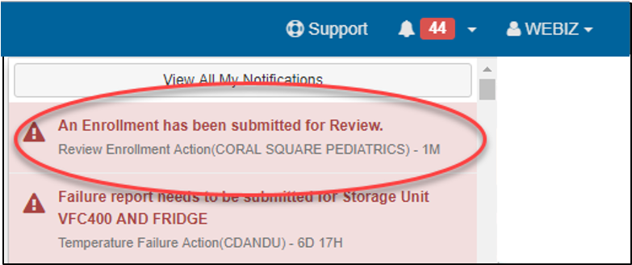
Review Enrollments
Users with the following access can review and approve or deny enrollment templates:
Program Tools module access
PM – Manage Enrollments user security function
Those users will also receive notifications when enrollments are submitted and ready to be reviewed

Slide 36
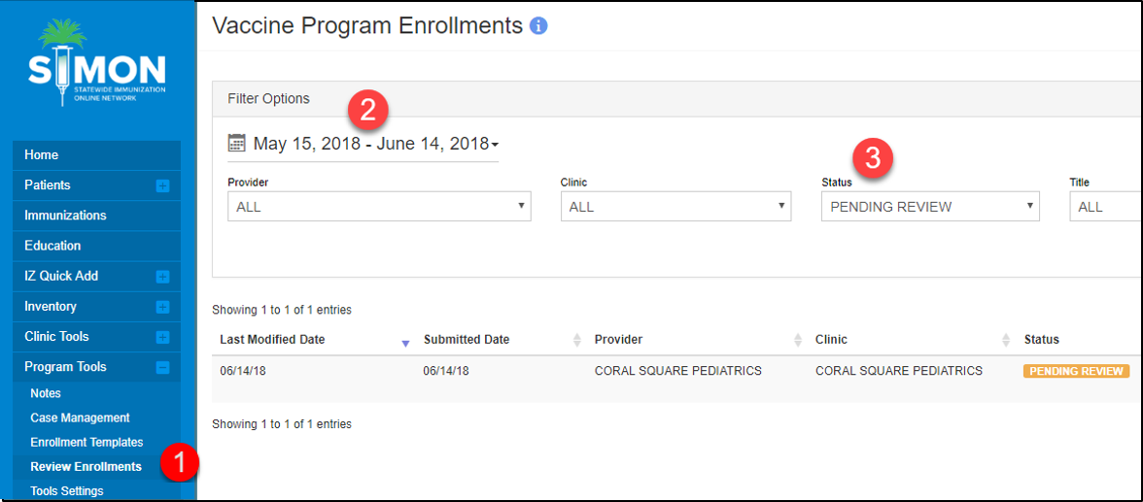
Review Enrollments (cont.)
Navigate to Program Tools > Review Enrollments.
By default, enrollments are filtered by the previous 30 days.
By default, enrollments are filtered by Status = Pending Review.

Slide 37
Review Enrollments (cont.)
Modify any filter options and click Filter to view results.
Click View to review enrollment details and approve or reject.

Slide 38
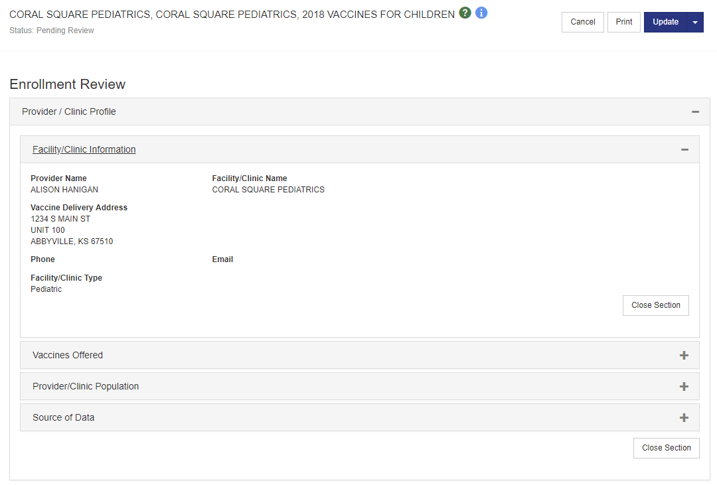
Review Enrollments (cont.)
Expand each section to review details.

Slide 39
Complete Additional Requirements
For each additional requirement:
Choose Pass or Fail.
Enter Date Completed.
If enrollment is VFC:
Enter or confirm Clinic’s VFC/VTrckS PIN.

Slide 40
Comments
Review any Clinic Comments submitted with the enrollment.
Optional: Enter any Jurisdiction Comments, such as reason(s) for rejection or condition(s) of approval.

Slide 41
Approve/Reject Enrollment
Click the split action Update button.
Select to Approve or Reject the Enrollment.

Slide 42
Approved VFC Enrollments
Approval of any NEW VFC enrollment automatically updates the following fields on the Clinic page:
VFC/VTrckS PIN
VTrckS Status
Original VFC Certification Date
Renewal VFC Certification Date
Notes:
If the enrollment is noted as a VFC Enrollment (has ‘Is VFC’ selected on the Enrolment Template)
And the PIN was already present in the Clinic Profile (not a new enrollment)
Then – populate the Renewal VFC Certification Date with the current date, set the VTrckS status to Active and clear the Suspended Reason field.

Slide 43
User Registration

Slide 44
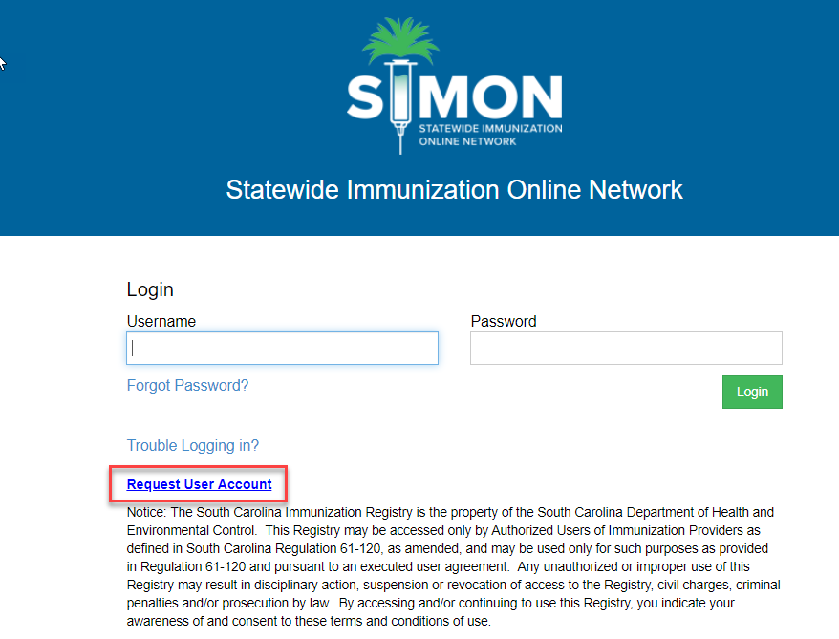
User Registration
Users request a new user account via the User Registration link on the login page.

Slide 45
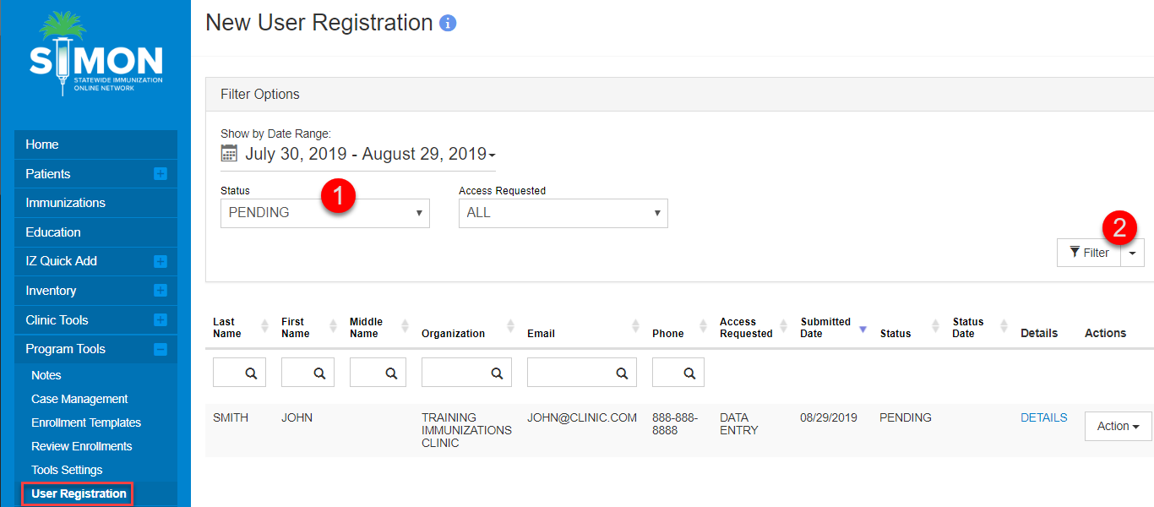
Pending User Registrations
Select ‘Pending’ status and click Filter to view any pending User registrations.

Slide 46
Create/Deny User Registration
Click the Action button next to the User Registration line item.
Select Create or Deny

Slide 47
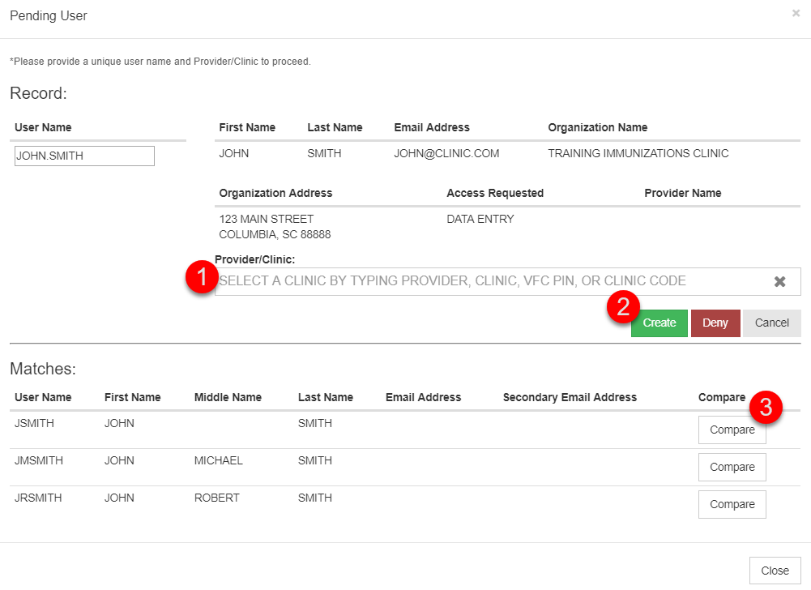
Create User Registration (cont.)
Enter a Provider/Clinic to associate user to
Click Create to create the user account
Click to compare to already existing user accounts

Slide 48
Deny User Registration
Select the denial reason
Enter in any comments pertaining to the denial reason
Click Deny

Slide 49
Reports

Slide 50
Reports
VFC Provider/Clinic Population
Vaccine Program Enrollments

Slide 51
VFC Provider/Clinic Population
Allows Program users to print Provider Population data for all clinics so that it can be data entered into VTrckS.

Slide 52
Vaccine Program Enrollments
Provides users at the jurisdiction with a tracking mechanism for clinic enrollments.

Slide 53
Questions?

